Slide 1
GGSB Prelim Q2 – Hang Chen
Gene therapy: treating genetic disorders using genetic approaches
Major class of diseases that are conducive to gene therapy:
  Monogeneic: easy to target
  Loss-of-function or haploinsufficiency: easy to rescue
  Many are also hematological diseases: easy to access
  Lower-level restoration: easier to molecularly fix cells than tissues
Dx | Cause | Gene | Gene changes | Location | Vector
X-linked Severe Combined Immunodeficiency (SCID) | Lymphocytes development deficiency | IL2RG | Mutations in IL2RG gene | Ex vivo | RV
Thalassemia | Less alpha or beta hemoglobin | HBA1/2 and/or HBB1/2 | Mutations in HBA1/2 and/or HBB1/2 genes | Ex vivo | AAV
Sickle cell anemia | Hemoglobin polymerization | HBB | A mutation in both HBB alleles | Ex vivo | AAV
Congenital hemophilia | Blood does not clot properly | F8 and/or F9 | Mutations in F8 or F9 genes | In vivo | AAV
Vision Loss | Impaired retinoid cycle | RPE65 | Mutations in RPE65 gene | In vivo | AAV
Spinal muscular atrophy (SMA) | Insufficient survival motor neuron protein (SMN) | SMN1 | Mutations in SMN1 gene | In vivo | AAV
High et al., 2019

Slide 2
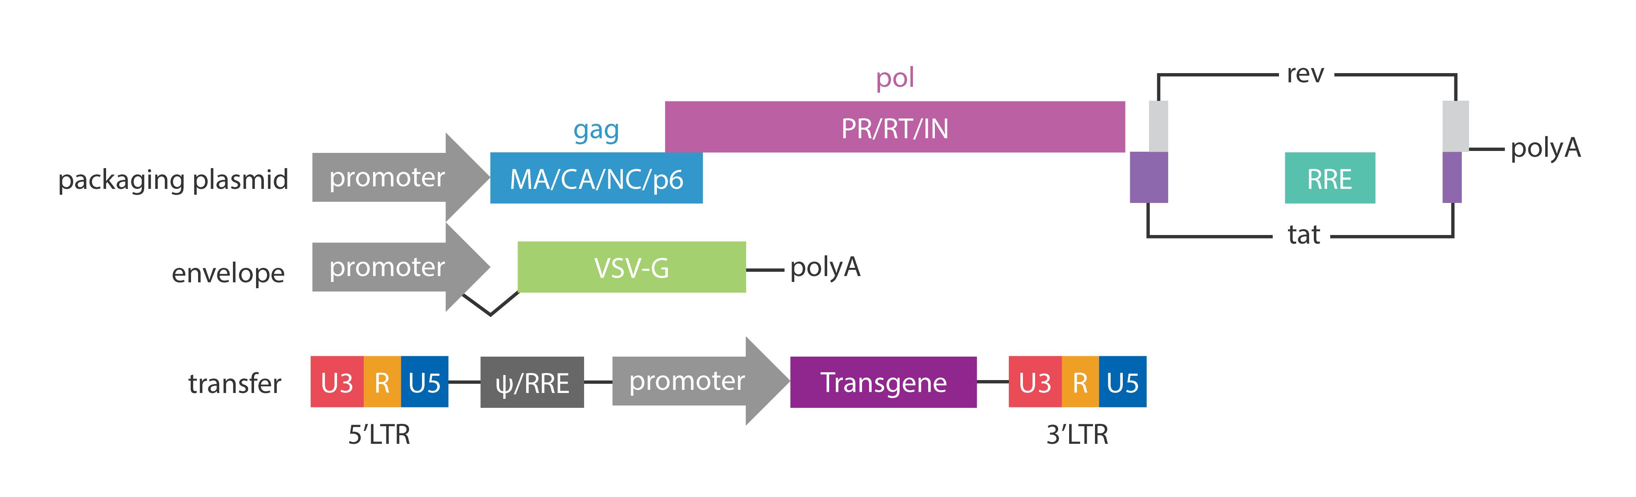
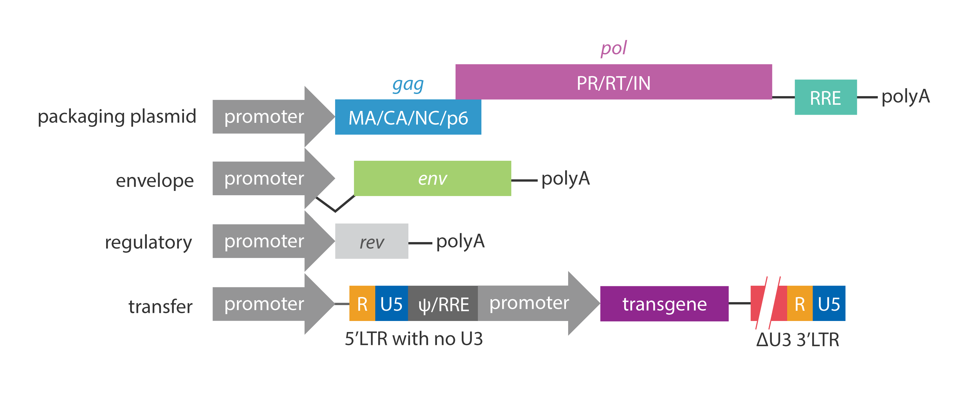
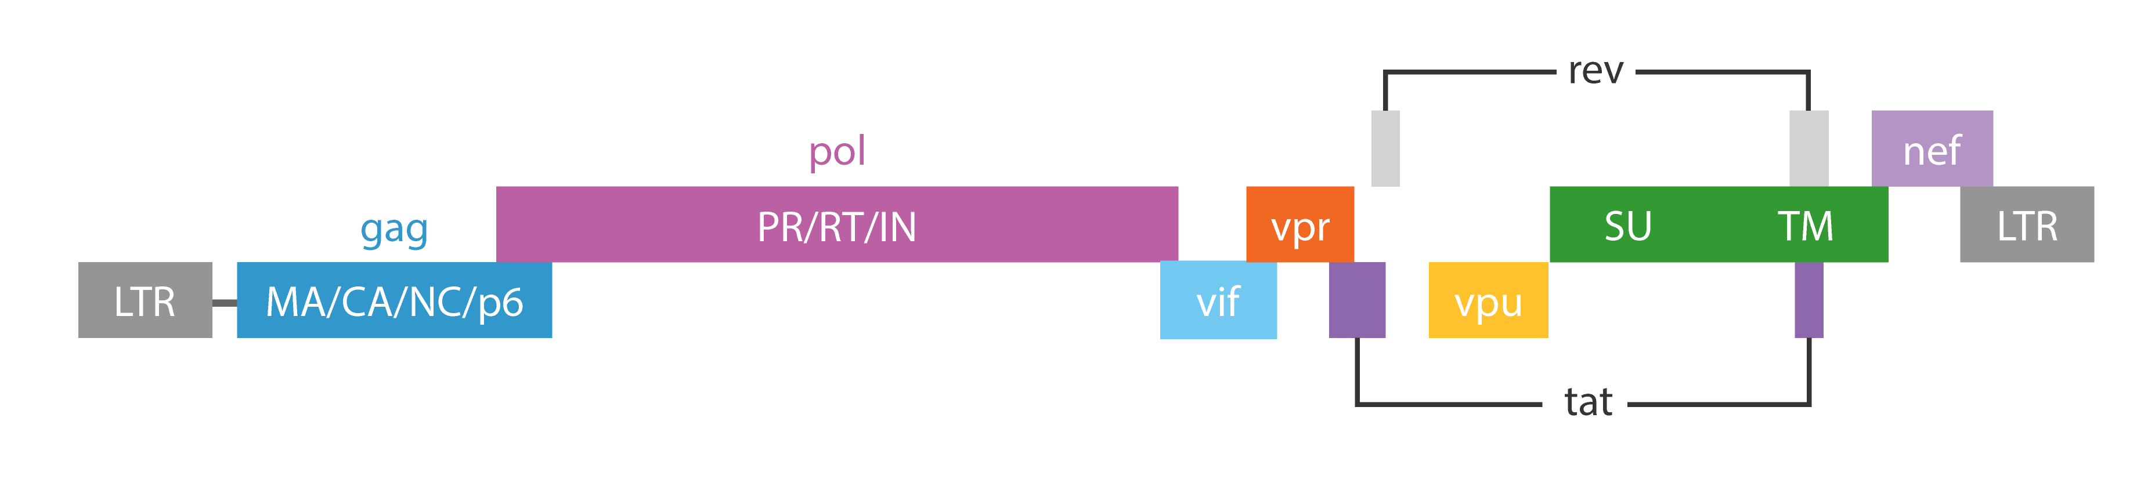
Lentivirus (LV)
Type
  Retrovirus (enveloped)
Genome
  Single stranded positive sense RNA
  ~10kb
  5’ and 3’ LTRs: required for transcription and reverse transcription
  gag: core
  pol: reverse transcription
  env: surface protein
  rev/tat: regulatory
  some other replication related genes
Recombined LV
Generation 2
Generation 3 (SIN)
Safer, but lower titer
env
Lentivirus genome
Abm Inc.

Slide 3
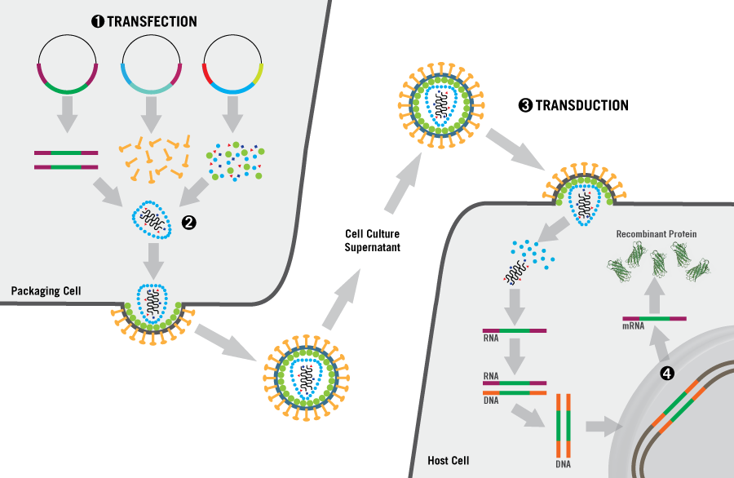
Recombined Lentivirus (LV)
Infection
  Tropism: VSV-G, for most cells
  Entry: membrane fusion and endocytosis
  Dividing cells (hard to cross nuclear membrane)
  Genome integration
Pros:
  Large capacity for transgene
  Easy to design (transfer plasmid)
  SIN system for safety
  Integrated into genome, permanent expression
Cons:
  Insertional mutagenesis risks
  Copy number issues
  Suited for:
    Dividing cells
    Permanent correction
    E.g., hematopoiesis diseases (ex vivo treatment)
Mirus Bio LLC

Slide 4
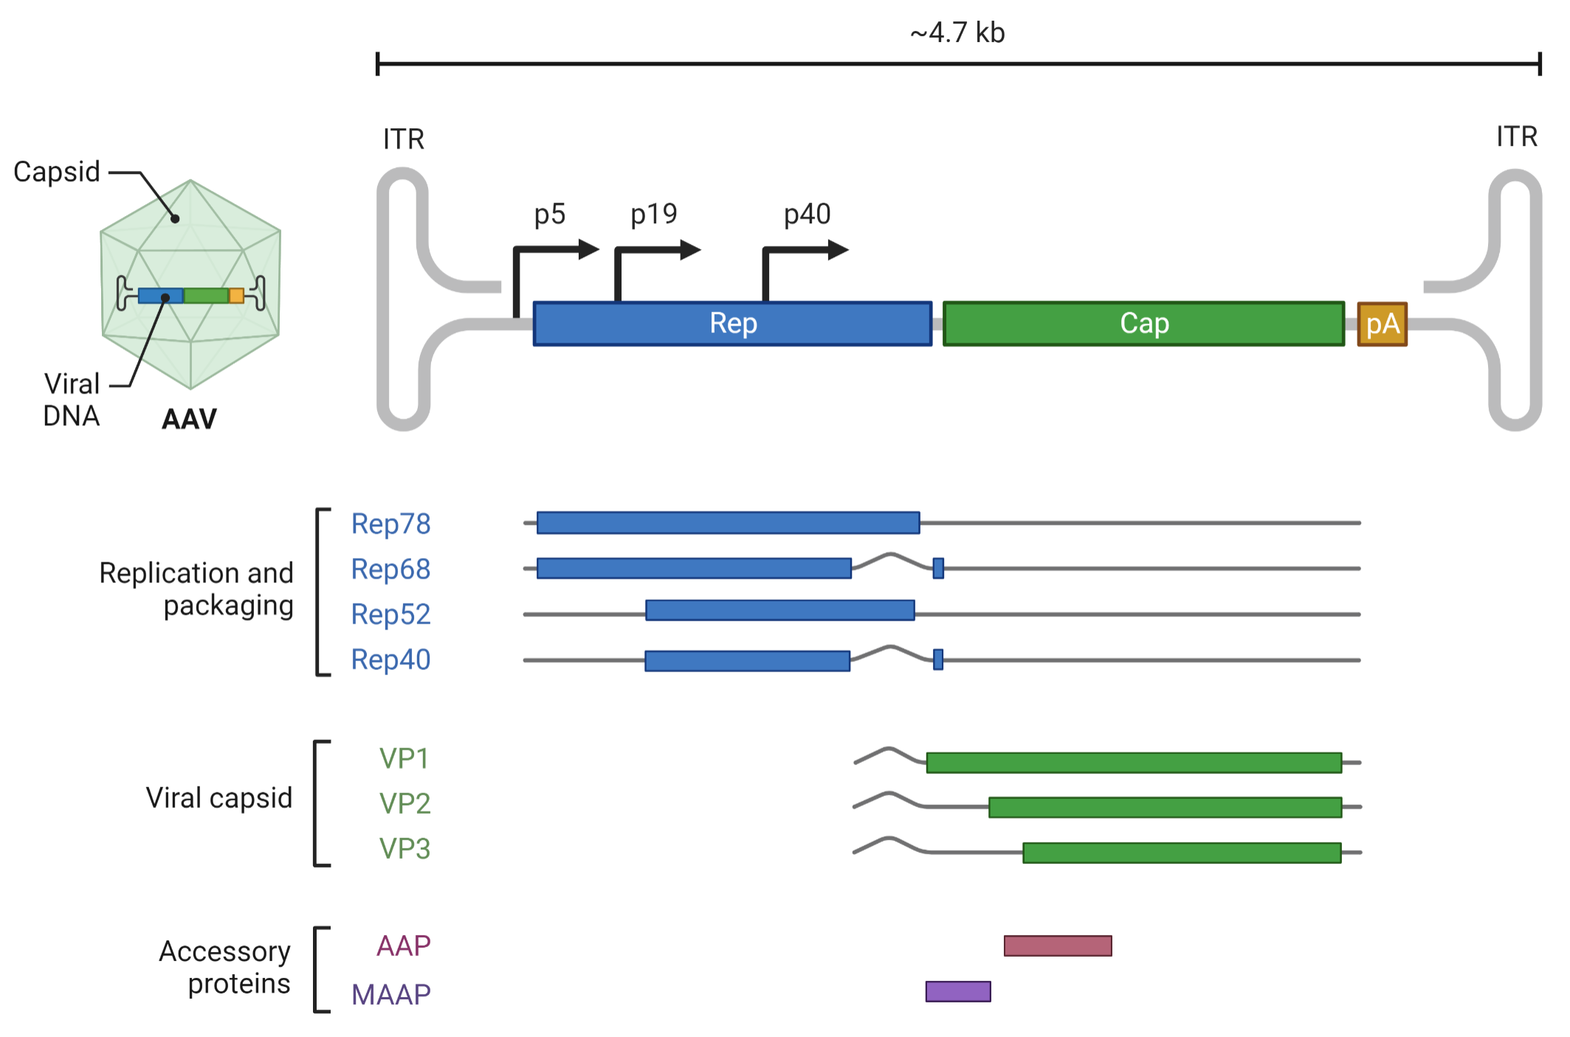
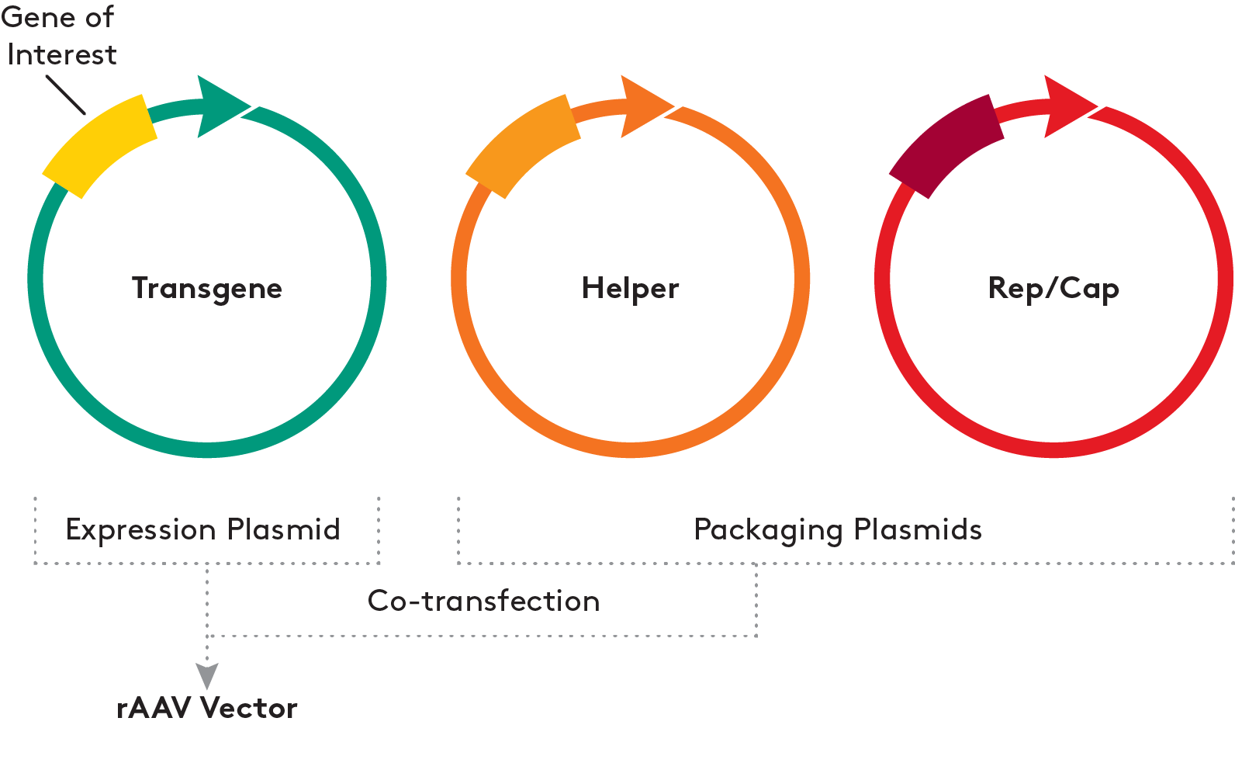
Adeno-associated virus (AAV)
Type
  Dependovirus (non-enveloped, rely on other viruses to help replicate)
Genome
  ssDNA
  ~4.7kb
  5’ and 3’ ITRs: required for the synthesis of the complementary DNA
  rep: replication genes
  cap: capsid genes
Dyno Therapeutics
Recombined AAV (rAAV)
transfer plasmid: ITR and transgene
helper plasmid: required for virus replication
rep/cap plasmid: may require special design for targeted cells
Aldevron

Slide 5
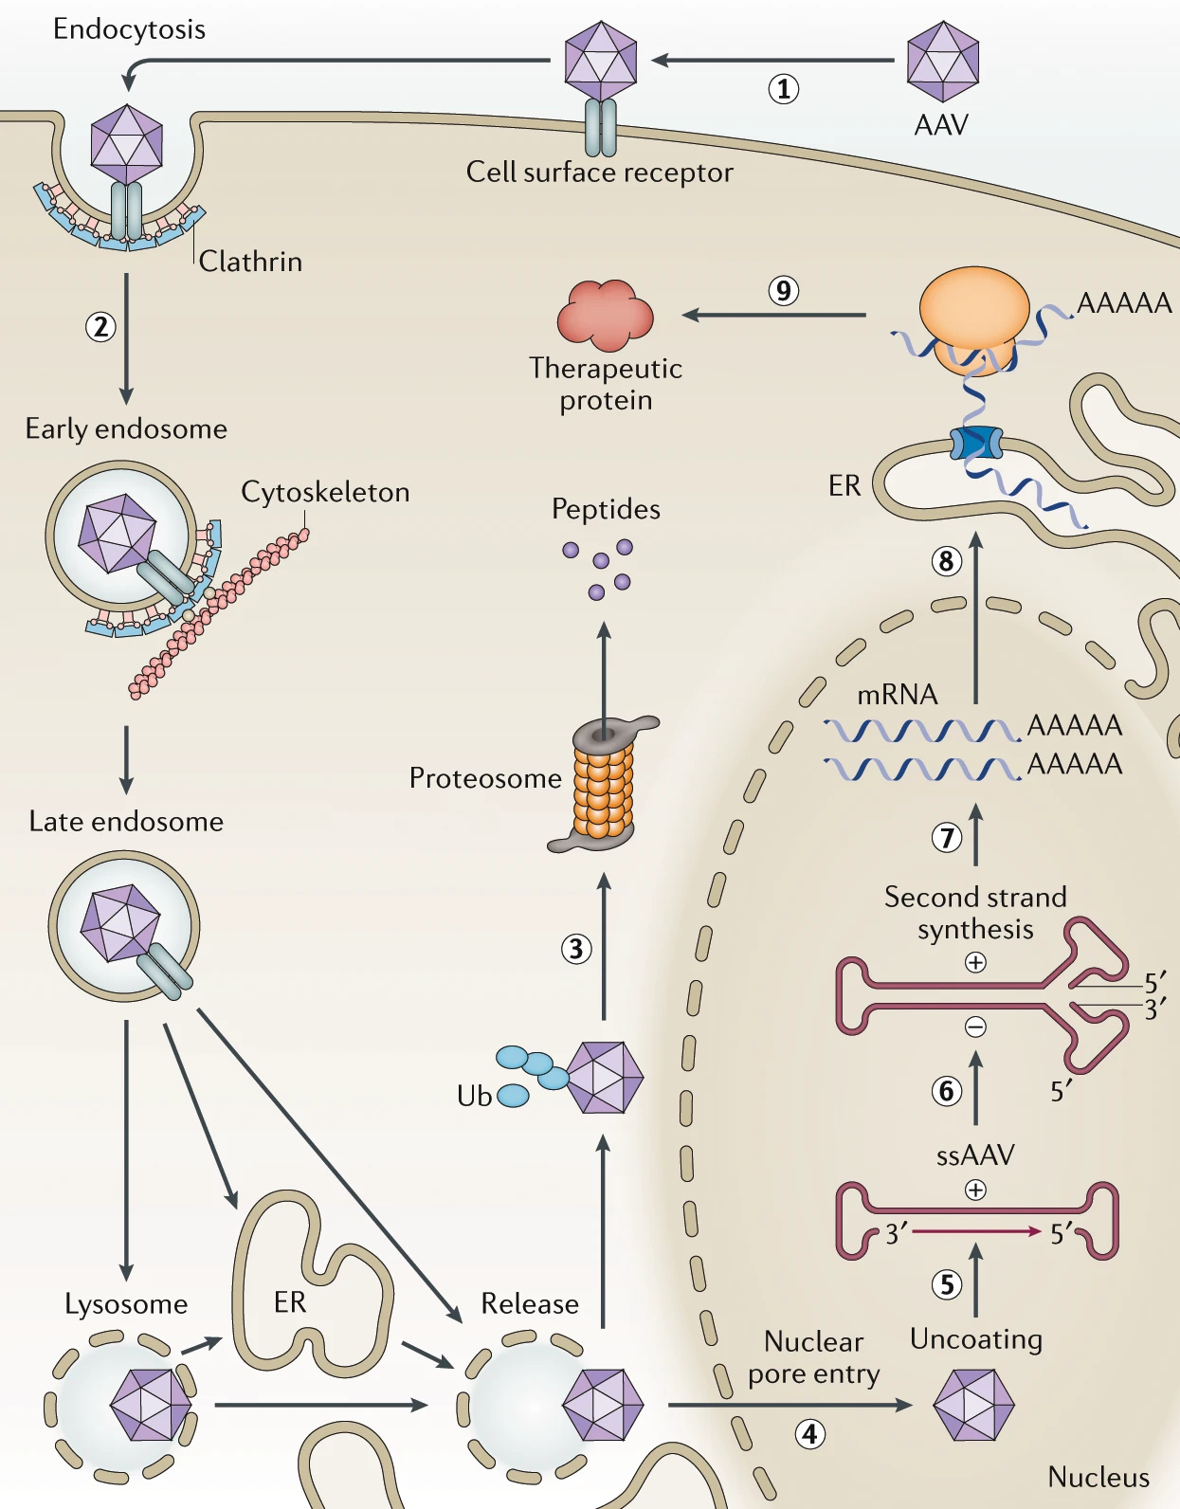
Recombined Adeno-associated virus (AAV)
Infection
  Tropism: more specific (may require optimization, e.g., directed evolution, in silico design)
  Entry: endocytosis
  Both dividing and non-dividing cells
  Very low genome integration
Pros:
  Tissue specificity
  Very low insertional mutagenesis risks (although it could happen if administrated in long term)
  AAV itself does not cause disease
Cons:
  Small capacity for transgene
  Complicated to design, hard to manufacture in large scale
  Some people may have immunity against naturally existing AAV, which can decrease the efficacy
  Suited for:
    Non-dividing cells
    Transient expression
    E.g., neurological disorders (in vivo treatment)

Slide 6
Challenges
Ethics
  Bottomline: no germline editing
Safety
  Genotoxicity (insertional mutagenesis, copy number issues)
Efficacy
  Delivery (tropism, immunity, cell migration)
Cost
  Up to $1.2 billion per patient
Some other directions:
  ASO (RNAi issue)
  CAR-T CAR-NK (exhaustion issue)
  Maybe SARS-CoV-2 as a vector in the future?
  (~30Kb capacity, strong infection ability)
Special thanks to Xiaochang Zhang group.

